Slide 1
AdwentureWorks sales
Presentation

Slide 2
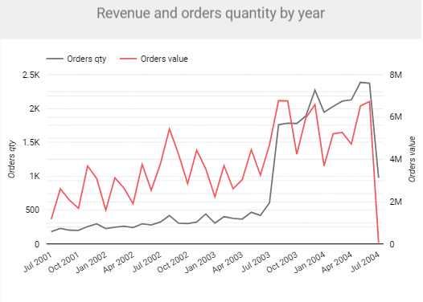




The growth of revenue was almost twice
compare average of month revenue in 2001 (2,387,925.37$)
to average of month revenue in 2004 (4,599,558.92$).

Slide 3
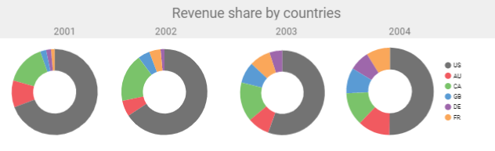
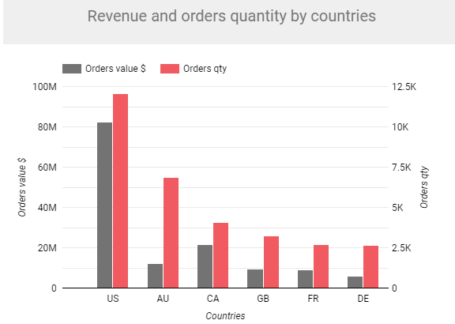
69.3%
65,7%
55,5%
50,2%
The biggest part of revenue and orders came from US clients.
Only in 2004 the share between countries a little bit changed.

Slide 4
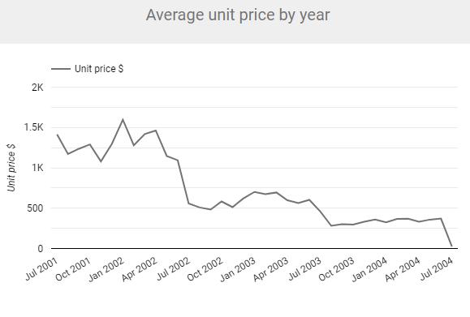
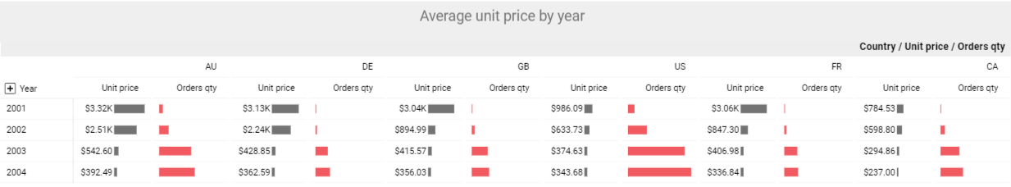
The average of unit price in July of 2003 (281.58$ ) is ~49% lower
compare to the same period in 2002 (559.05$)
and ~80% lower compare to July of 2001 (1,413.97$).

Slide 5
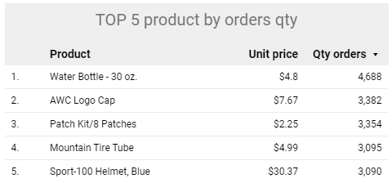
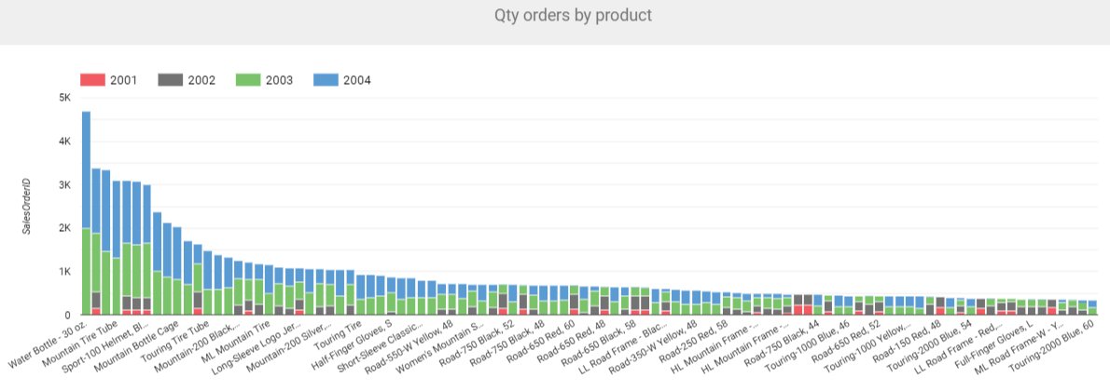
Average unit price decrease was caused by the adding the new cheap products in the assortiment.

Slide 6
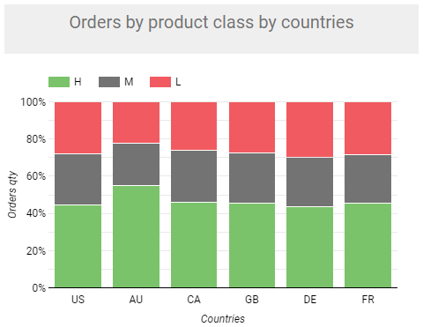
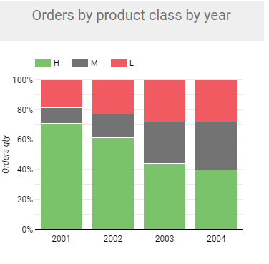
The cheap price products coming determined the clients habits changes.
The sales of low class products increased from 18.79% in 2001
till 39,61% in 2004 year.
*
*
18,79%
28,29%
70,84%
* H – high, M- medium, L-low
39,61%
* H – high, M- medium, L-low

Slide 7
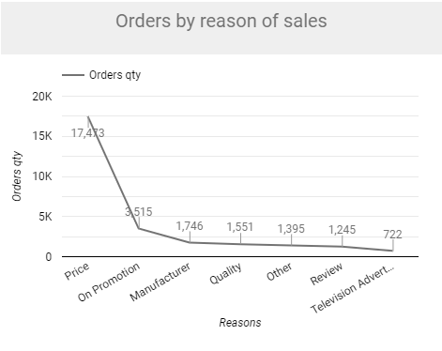
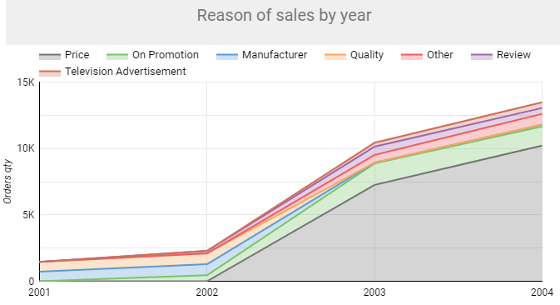
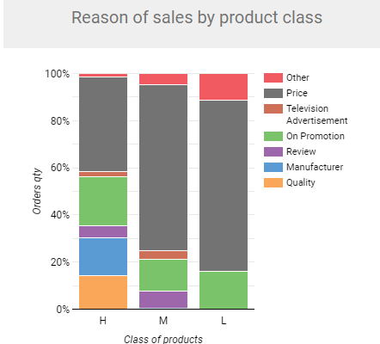
Pricing politics changes determined the changes of clients habits.
The price became the main reason of sales.
72,53%
* H – high, M- medium, L-low

Slide 8
Recomendations
Try to keep the same growing of customers activity without price level loses.
To check and evaluate assortment of expensive products. If it is need to add new products in high demand. To build an additional advertising strategy for such products.
To pay more attention for clients who tend to buy high quality goods.
To use sales reason research data for targeted marketing campaign.

